Slide 1
Employee Attrition Prediction using IBM HR Analytics Dataset
Pradyumna Chippigiri
Karan Bantia Ram
Govardhan Narasimha Murthy
Ashutosh Naik

Slide 2
Overview
Introduction & Motivation
Objectives
Dataset Overview
Process Pipeline
Data Preprocessing and EDA
Methodology
Results and Conclusion

Slide 3
Introduction & Motivation
Employee attrition, or turnover, is a critical aspect of workforce management that refers to the rate at which employees leave a company over a specified period.
Understanding and managing attrition is crucial for organizations to maintain a stable and productive workforce.
High attrition rates can negatively impact a company's productivity, morale, and overall performance.
Identifying factors contributing to attrition allows organizations to implement strategies for retention, cost reduction, and talent management.
Notes:
This project is motivated by the importance and opportunity in identifying and using data analytics to make positive changes and positively impact employees and organization as a whole.

Slide 4
Objectives
The goal is to offer a reliable and interpretable predictive model that accurately flags employees at high attrition risk and in identifying what factors contribute to employees leaving the company.
The primary objective is to extract meaningful insights that can inform strategic workforce management.
By analyzing this dataset, the aim is to identify patterns, correlations, and underlying causes contributing to employee attrition.
Notes:
The Employee Attrition Prediction project aims to leverage data analytics to formulate a robust predictive model for accurately identifying potential employee turnovers within organizations.
This initiative seeks to equip organizations with a valuable tool for enhancing their retention strategies, fostering a stable work environment, and ensuring continued growth and success.

Slide 5
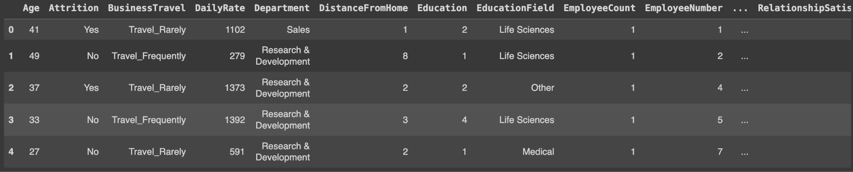
Dataset Overview
IBM HR Analytics Employee Attrition & Performance from Kaggle is used
The dataset contains data of 1470 employees each with 35 attributes.
The binary target class ‘Attrition’ which is the 2nd column indicates whether an employee leaves the company ‘1 = Yes’ or ‘0 = No’. This dataset can be used by companies to decide the future of the employees.
Notes:
These attributes describe various characteristics such as Age, Target Class, Business Travel, Daily Rate, Department, Distance From Home, Education, Education Field, Employee Count, Employee Number, Environment Satisfaction, Gender, Hourly Rate, Job Involvement, Job Level, Job Role, Job Satisfaction, Marital Status, Monthly Income, Monthly Rate, Num Companies Worked, Over 18, Over Time, Percent Salary Hike, Performance Rating, Relationship Satisfaction, Standard Hours, Stock Option Level, Total Working Years, Training Times Last Year, Work Life Balance, Years At Company, Years In Current Role, Years Since Last Promotion, Years With Curr Manager.
No missing values.

Slide 6
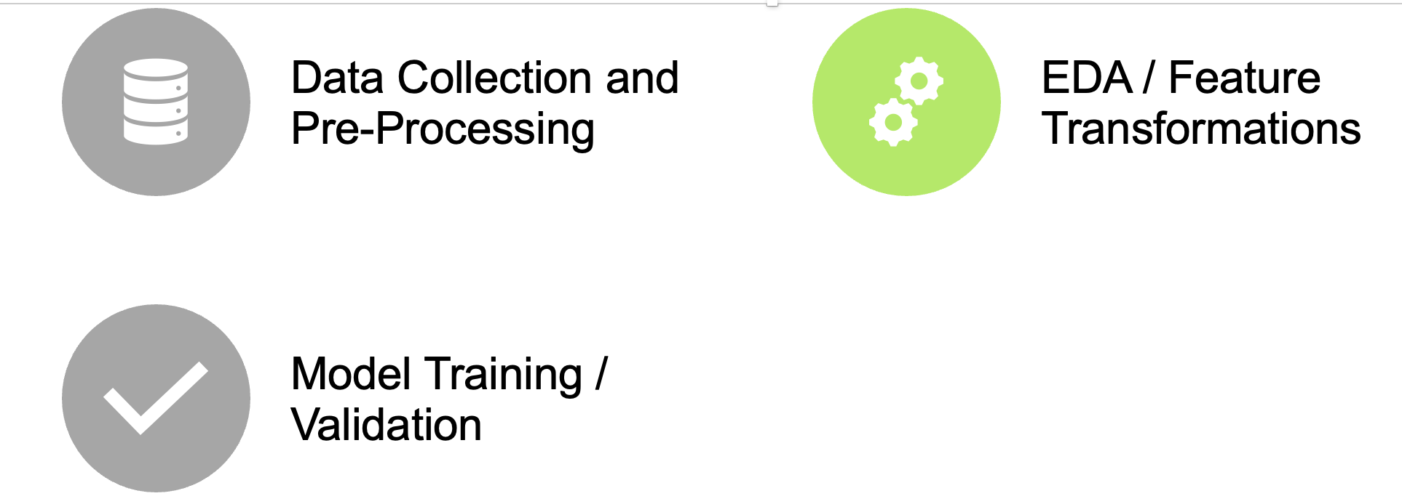
Process Pipeline

Slide 7
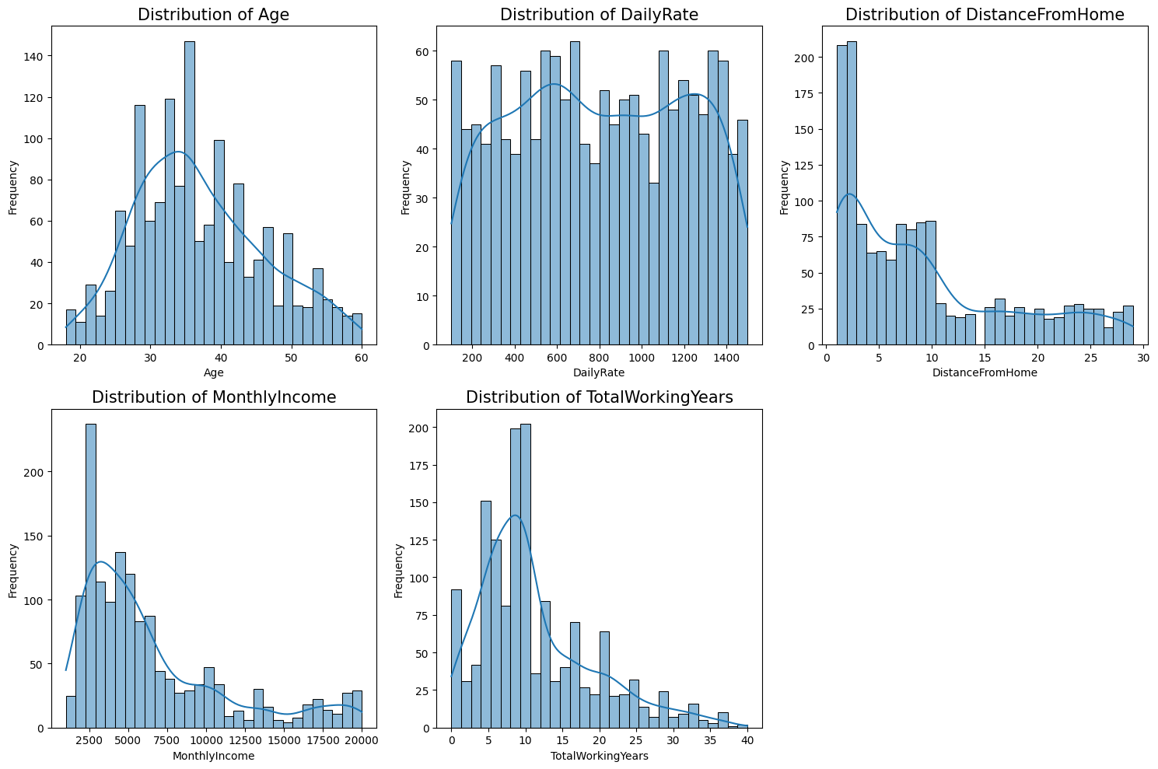
Data Preprocessing and EDA
Notes:
We began by first plotting the distribution plots for some key numeric columns to understand their distribution.
Age: The age distribution is somewhat right-skewed, with a larger number of younger employees in the dataset. The peak is around the mid-30s.
DailyRate: The distribution for the daily rate seems relatively uniform, with no specific pattern or prominent peaks.
DistanceFromHome: The distribution is right-skewed, indicating that many employees live closer to their workplace.
MonthlyIncome: The monthly income distribution is right-skewed, showing that a significant number of employees earn a lower monthly income, with fewer employees in the higher income brackets.
TotalWorkingYears: This distribution is also right-skewed, suggesting that many employees have fewer total working years, which aligns with the younger age distribution.

Slide 8
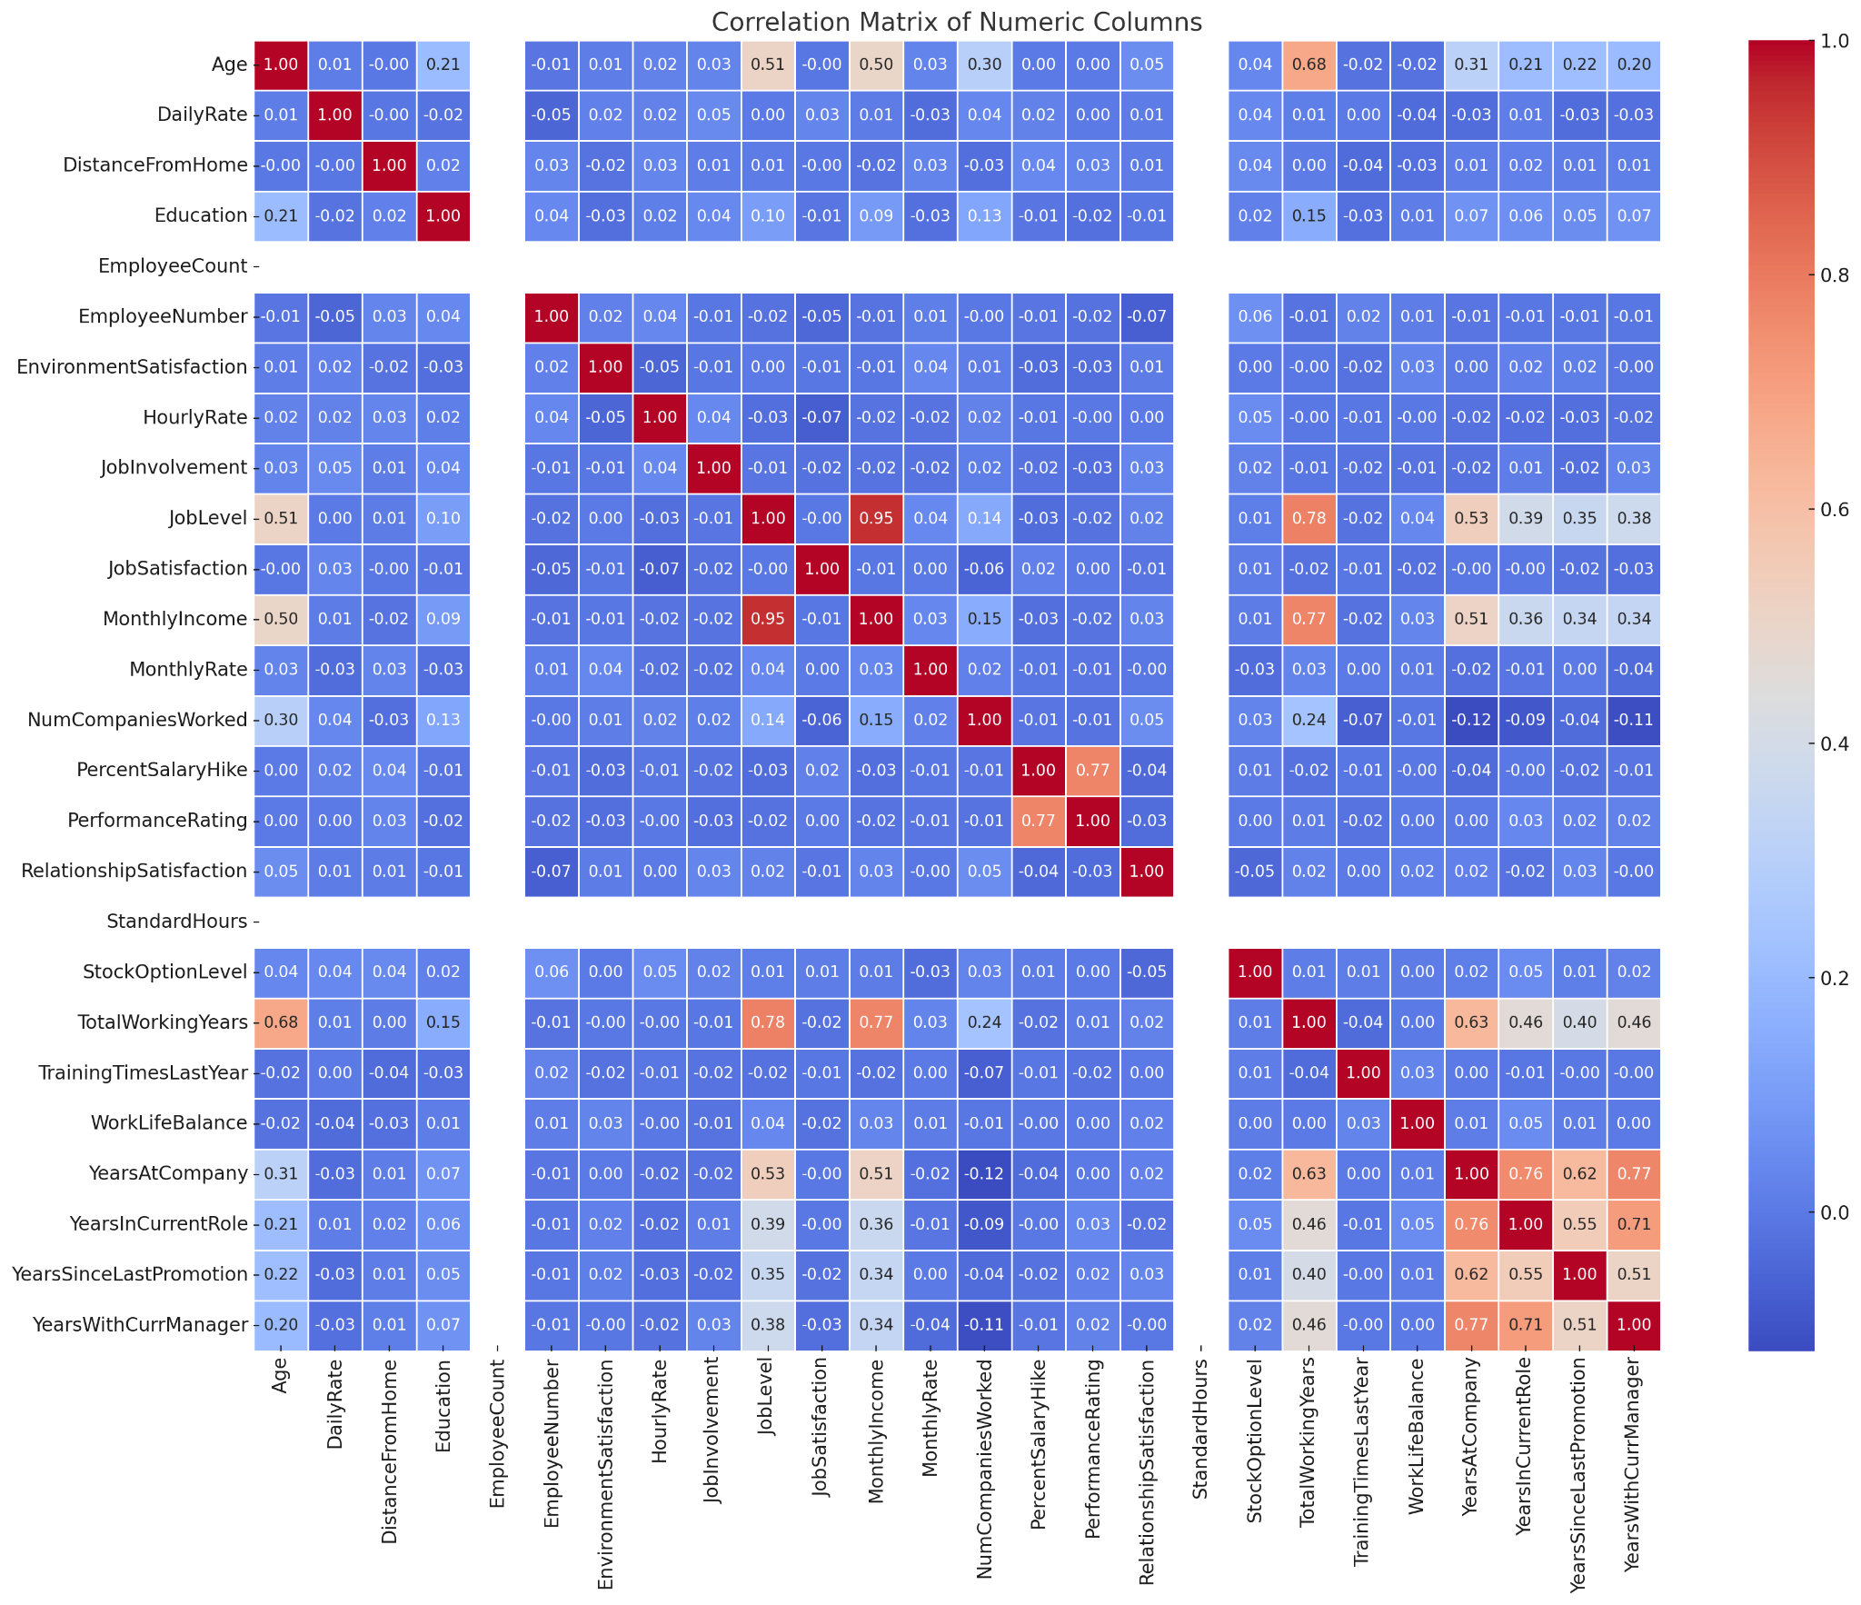
Data Preprocessing and EDA
TotalWorkingYears has a strong positive correlation with Age (0.68)
MonthlyIncome is positively correlated with JobLevel (0.95).
YearsAtCompany has a positive correlation with YearsWithCurrManager (0.77) and YearsInCurrentRole (0.76).
Notes:
We then proceeded to plot a correlation heatmap matrix to look at any correlations at a glance. Some things that stand out here:
TotalWorkingYears has a strong positive correlation with Age (0.68), which is expected. As employees get older, they accumulate more working years.
MonthlyIncome is positively correlated with JobLevel (0.95). This suggests that as employees move up in job levels, their monthly income generally increases.
YearsAtCompany has a positive correlation with YearsWithCurrManager (0.77) and YearsInCurrentRole (0.76). This indicates that employees who've been at the company longer tend to have been in their current role longer and with the same manager for a longer time.

Slide 9
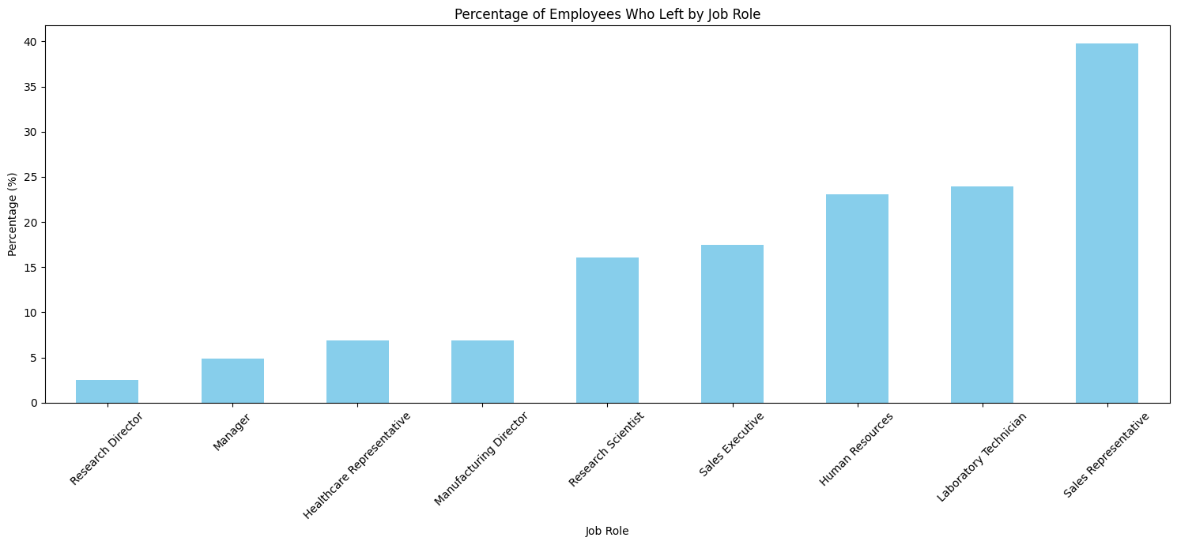
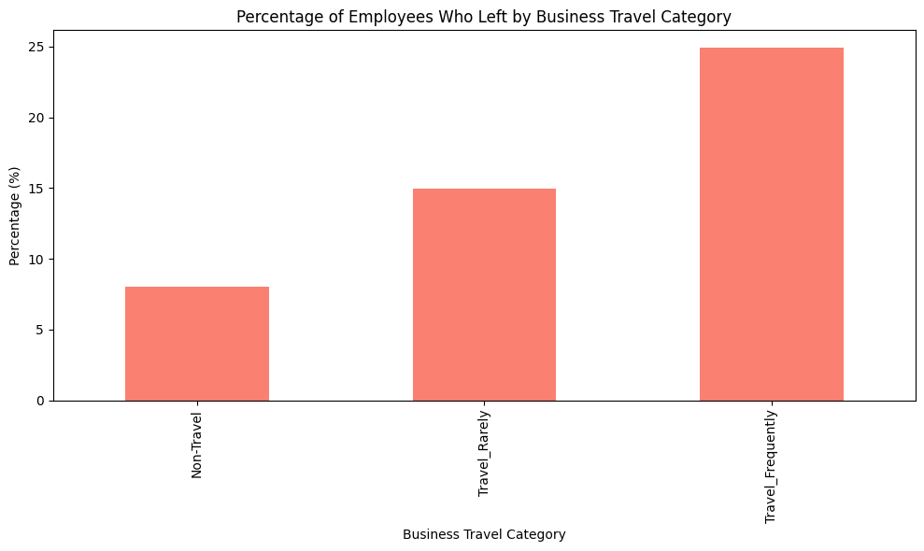
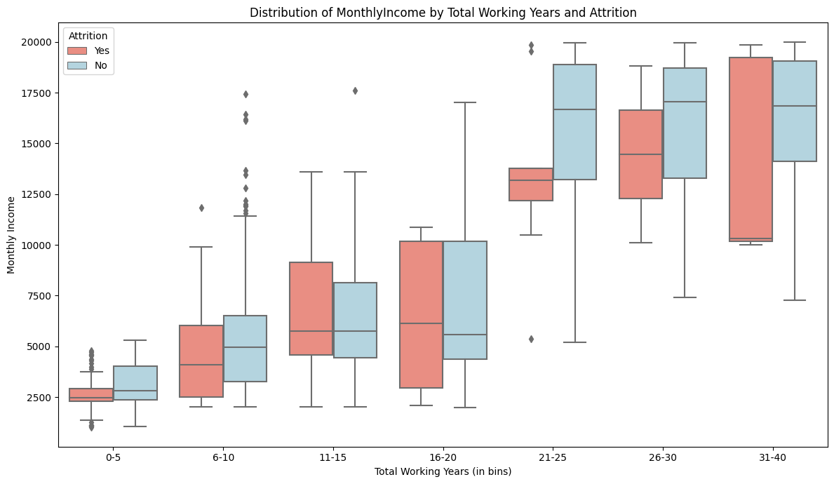
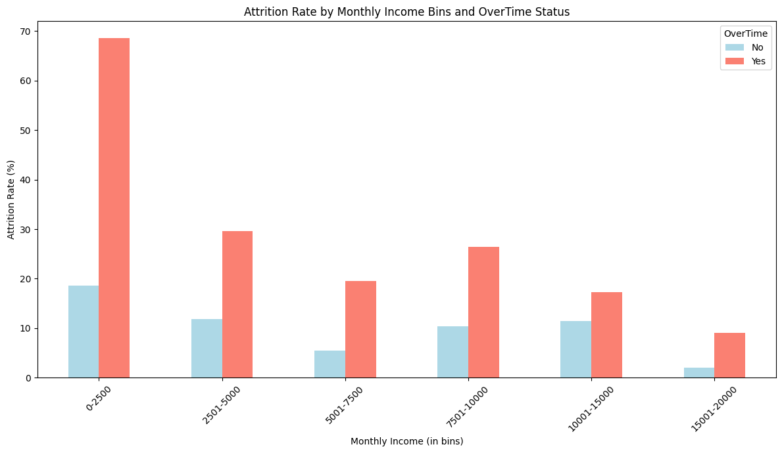
Data Preprocessing and EDA
Notes:
This graph gives an overview of job roles with higher attrition risk
Sales Representative has the highest percentage of attrition, with over 40% of employees in this role leaving the company.
Roles like Research Director, Manager, and Healthcare Representative have relatively low percentages of attrition, all below 10%.
Other roles such as Laboratory Technician, Human Resources, and Sales Executive also have notable percentages of attrition.
This graph provides insights into how the frequency of business travel causes employee attrition. Employees who travel frequently have the highest percentage of attrition, nearing 25%. These insights indicate that the frequency of business travel could be a potential area of concern when addressing employee attrition. Frequent business travel might lead to burnout, work-life imbalance, or other factors that contribute to higher attrition rates.
This box plot shows the distribution of monthly income by total working years and attrition. As expected the monthly income generally increases with more working years which reflects career progression. The findings suggest that income disparity might influence attrition more significantly at the beginning and later stages of an employee's career.
This plot here shows that employees with lower incomes who also work overtime are a very high risk of leaving the company.

Slide 10
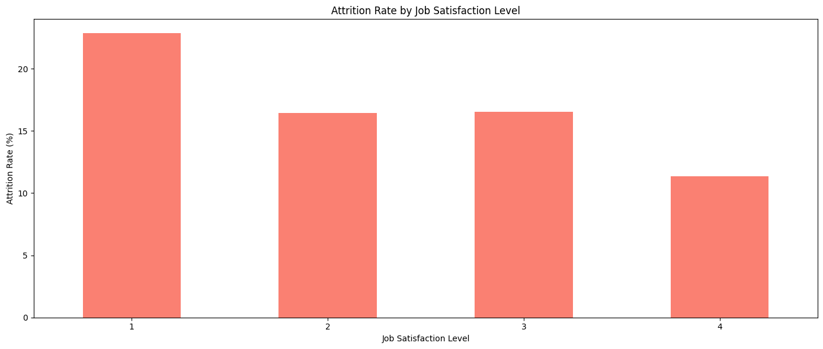
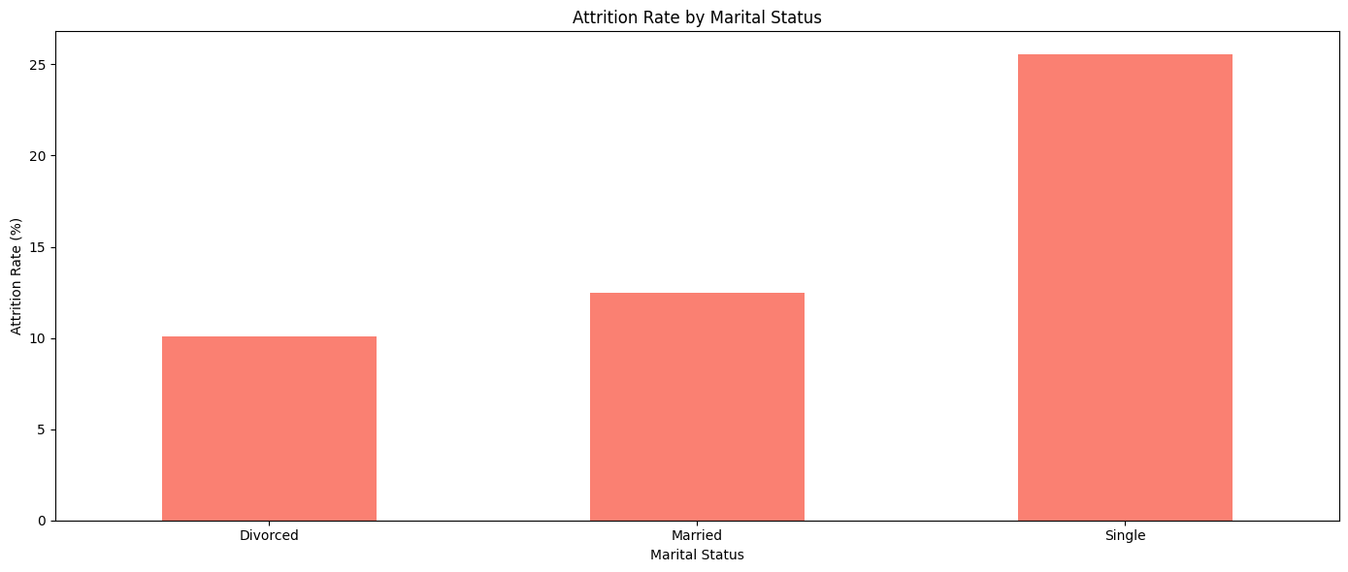
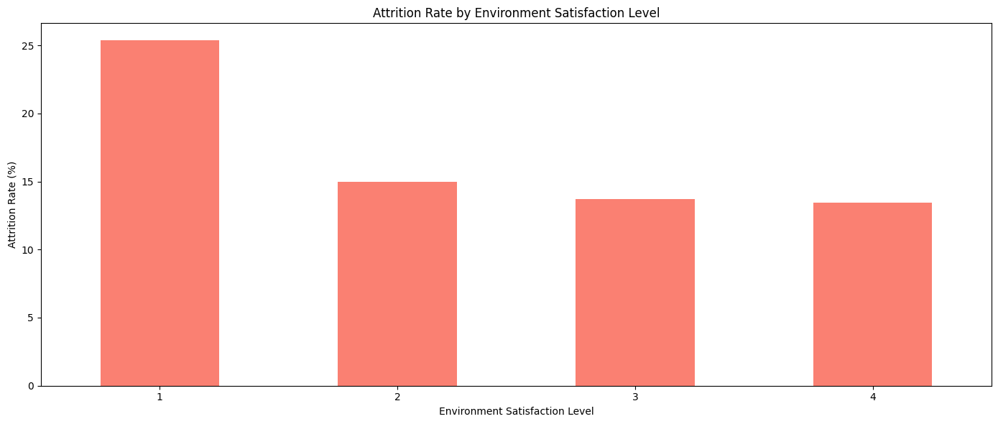
Data Preprocessing and EDA
Notes:
These two graphs show that attrition is higher among employees who have lower job satisfaction and environment satisfaction which indicates the importance of these two factors.
While this graph here indicates that single employees are at the highest risk of attrition as compared to married/divorced employees. This could also just be due to the fact that single employees are generally younger than married/divorced employees.

Slide 11
Methodology
The process of feature extraction and model implementation involved several stages:
Categorical Variable Encoding: Convert categorical variables into numerical representations suitable for machine learning algorithms.
Dimensionality Reduction: Employ Principal Component Analysis (PCA) to reduce the number of features while preserving essential information.
Data Standardization: Standard Scaler ensured all features had similar ranges, preventing biases during model training.
Train-Test Split: The data was divided into separate training and testing sets.
Class Imbalance Addressing: SMOTE technique was used to address imbalanced datasets, ensuring unbiased model performance across all classes.
Model Training: Various models were trained using the training data, and their performance was evaluated on the unseen test data.

Slide 12
Methodology : Categorical Variable Encoding
The dataset contained numerous categorical variables such as Education, Job Involvement, Job Satisfaction, Performance Rating etc.
These data will not be suitable for training Machine Learning Models and has to be converted to numerical data.
Label Encoder was used to convert these categorical variables into Numerical Values, which assigns a Unique Number to each Class present in the Column.
For Example : Education Column contains various classes namely “Below College”, “College”, “Bachelors”, “Masters”, “Doctor”. Label encoder will assign Unique Numbers to all the classes so that it will be suitable for training

Slide 13
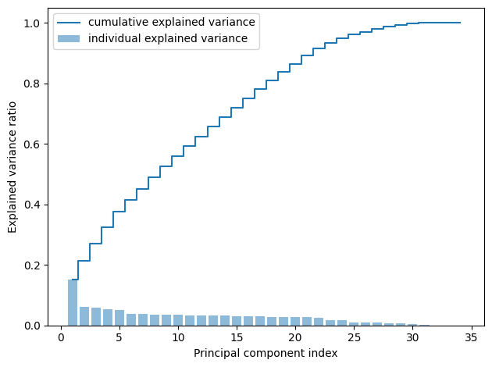
Methodology : Dimensionality Reduction
Dimensionality Reduction aims to reduce data complexity while preserving essential information which will be particularly helpful in High Dimensional Data.
Principal Component Analysis (PCA) is a key method in this context. It works by transforming and standardizing variables into uncorrelated principal components, sorted by their variance.
When PCA was applied to our data we saw that first 23 Components preserve over 90% of the date and can be considered for Training

Slide 14
Methodology : Data Standardization
Each Column will have values with different ranges. For Example some Columns will have data varying from -1000 to 1000 and some will have data varying from 0 to 1
This will create bias when we are training the model as the data with higher range will be given more significance. To correct this we should scale the data in all the columns to a single range to avoid the bias in training.
One way to achieve this is by using Standard Scaler which will scale the data such that it will have 0 as mean and 1 as Standard deviation.

Slide 15
Methodology : Train and Test Split
Our data has to be divided into two sets, Train Set and Test Set. This is because we can use the Train Set to train the models and then once the model is trained we can use the Test set to evaluate the model’s accuracy, precision.
We split the data with 30% of the data being Test set and 70% of the data for Train Set.
This can be implemented using train_test_split function available in sklearn

Slide 16
Methodology : Class Imbalance Addressing
Our Current DataSet had a class imbalance with 83% of the data giving the target variable (Attrition) as “No” and 17% of the data with “Yes”
This will create class imbalance and models will tend to have bias towards majority class
To correct this we employed Synthetic Minority Over-sampling Technique (SMOTE). SMOTE creates more data points by for the minority class by interpolating between existing points.
This will increase the model accuracy, reduce bias and is also simple to implement.
After implementing SMOTE the distribution of different classes of target variables was 54% and 46%.

Slide 17
Methodology : Model Training
Once all the preprocessing is done and data is split into train and test set. Our data will be ready for training the models. Some of the models which we trained were
Logistic Regression
Artificial Neural Networks (4 hidden layer and 1 output layer)
Decision Tree Classifier
Naive Bayes Classifier
Random Forest Classifier
Once the models are trained we will evaluate the accuracy of the models and compare the values and see which model performs better for our dataset and select that model for testing new data.

Slide 18
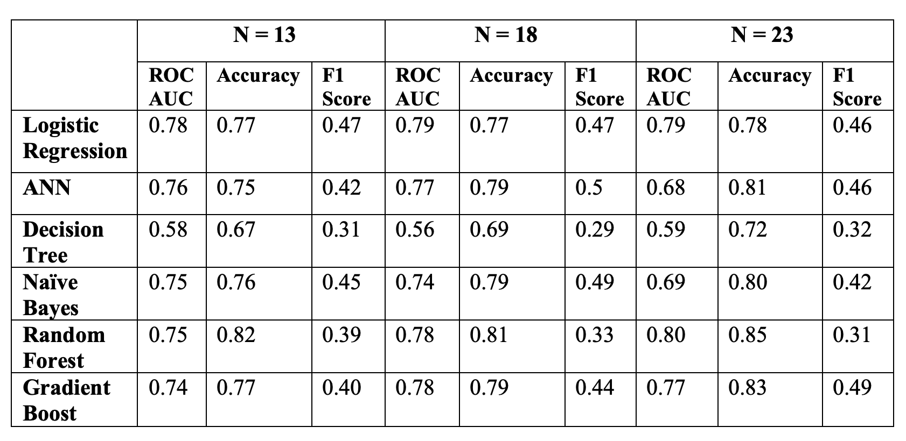
Results and Conclusion
Results obtained after performing the model evaluation using different ML models and PCA with varying numbers of components is shown in the table and plots below

Slide 19
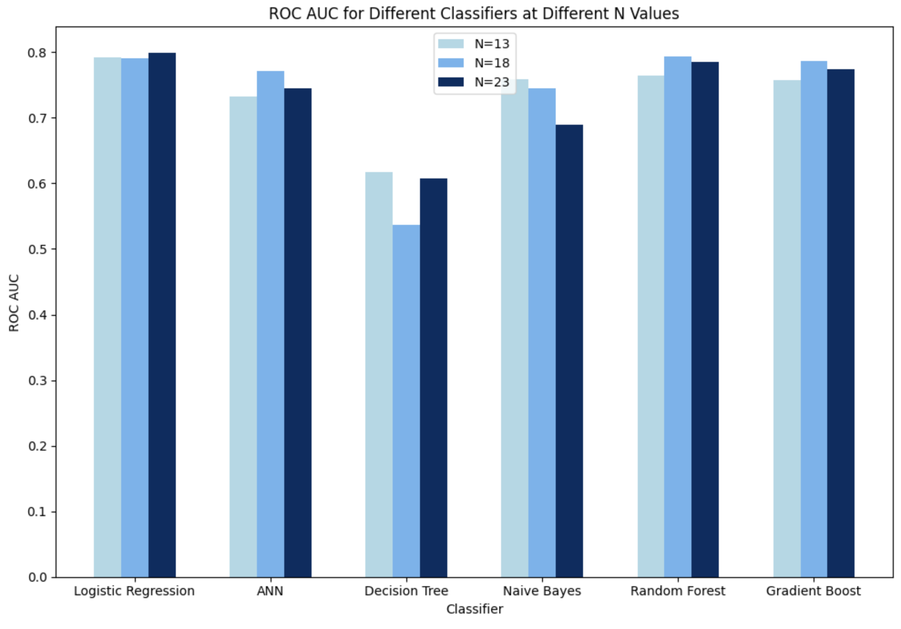
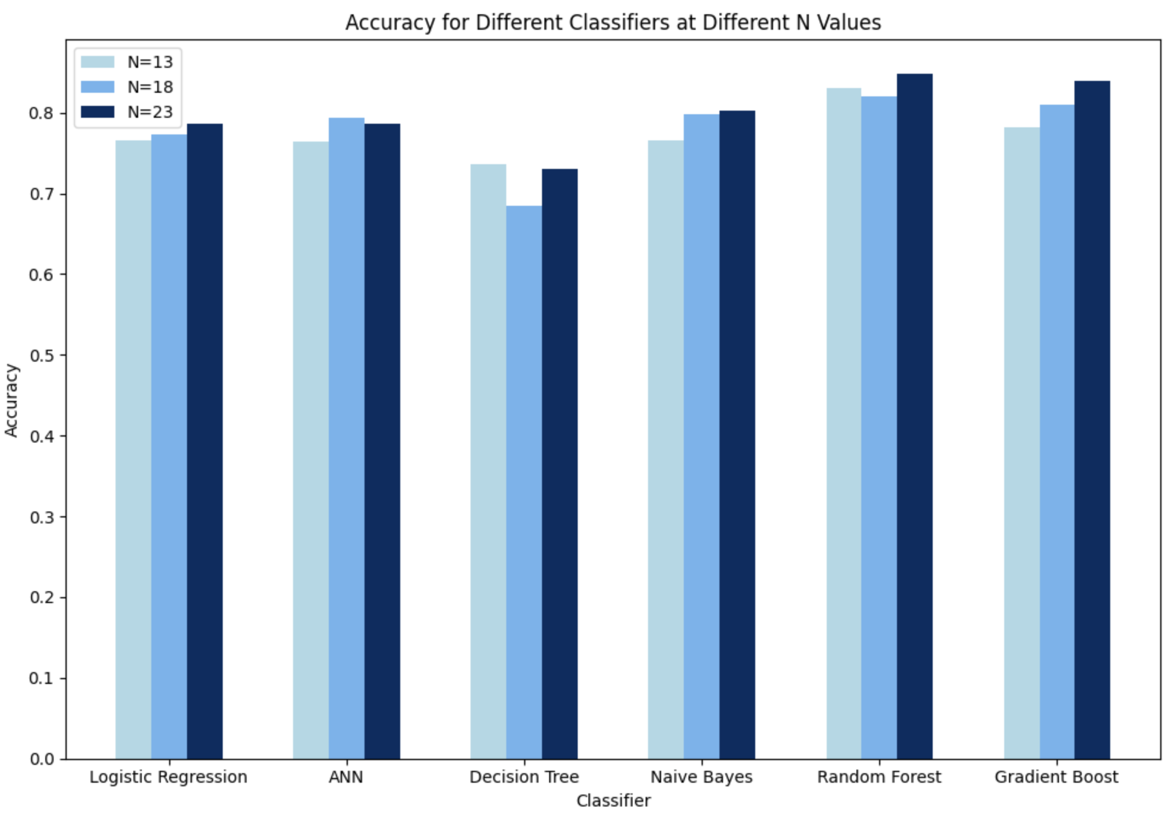
Results and Conclusion

Slide 20
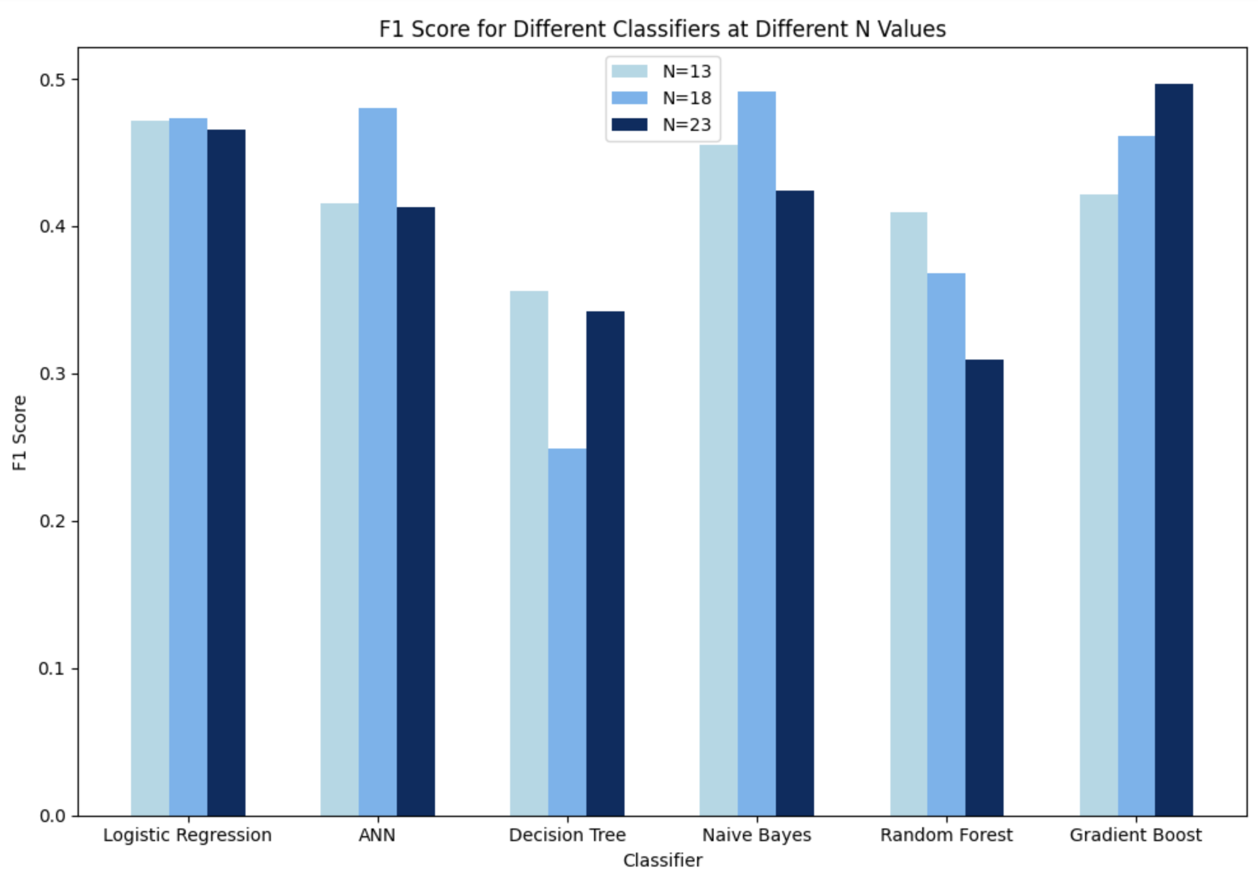
Results and Conclusion
Logistic regression has a stable performance with N.
Gradient Boost algorithm achieves the highest F1 score as the N values increases.
In random Forest Classifier the F1 score decreases with increasing N values.
In conclusion, based on the comparison on various models we can choose the model that best suits our requirement.

Slide 21
Thank you!

